Slide 1
CAR RENTAL SYSTEM
AMALA ROSE SEBASTIAN
22PMC109

Slide 2
ABSTRACT
This project is designed so as to be used by Car Rental Company specializing in renting cars to customers. It is an online system through which customers can view available cars, register, view profile and book car. The advancement in Information Technology and internet penetration has greatly enhanced various business processes and communication between companies (services provider) and their customers of which car rental industry is not left out.

Slide 3
REQUIREMENTS
Car rental system is divided into two modules:
User Module
Admin Module
User Module details:
View and book Available Cars
View car Booking details
Give query

Slide 4
Admin Module details:
Dashboard
Manage Vehicle brand
Manage Vehicle
Manage Bookings
Manage query
View Registered users

Slide 5
FEATURES
Easy Booking
Recommendations and User Feedback
Communication and Updates
Reservations Management
The new system is totally computerized system.
A new system provides features like time efficiency to show car details, user profiles and whatever the customer will give the feedback to the admin.

Slide 6
An inquiry is easily done by user in the system.
It is the most software application for managing online car rental business.
Enhance Business Processes

Slide 7
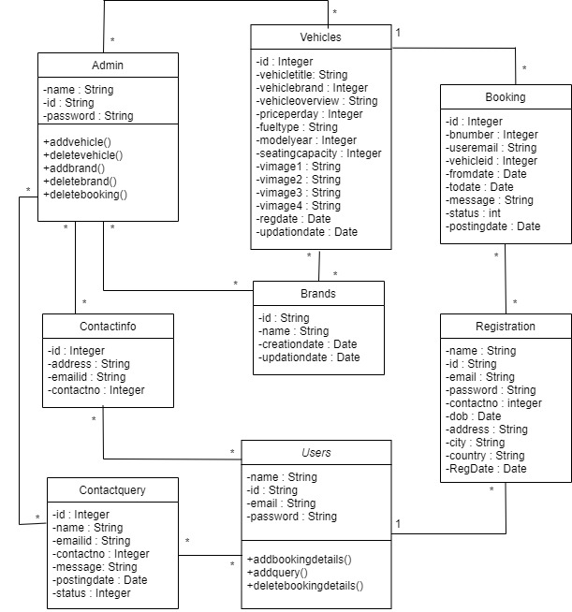
CLASS DIAGRAM

Slide 8
CHALLEGES
Designing an intuitive and user-friendly interface for users and administrators is crucial.
Fetching real-time availability and pricing information for rental services from external providers can be challenging.
Car Rental Management software typically requires user registration, login, and role- based access control. Implementing secure authentication and authorization mechanisms can be complex, especially when dealing with user roles and permissions.
Implementing validation mechanisms helps ensure that user input is accurate and consistent.
Designing an efficient database schema and managing the database operations can be complex.

Slide 9
FUTURE ENHACEMENTS
Quick and Secure Payments
Social Media Integration
Location-based Rentals
Multi-language Support

Slide 10
SCREENSHOTS

Slide 11
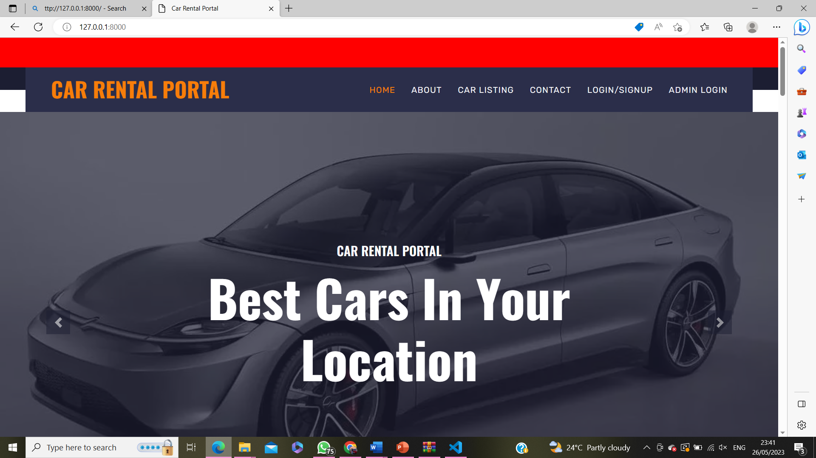
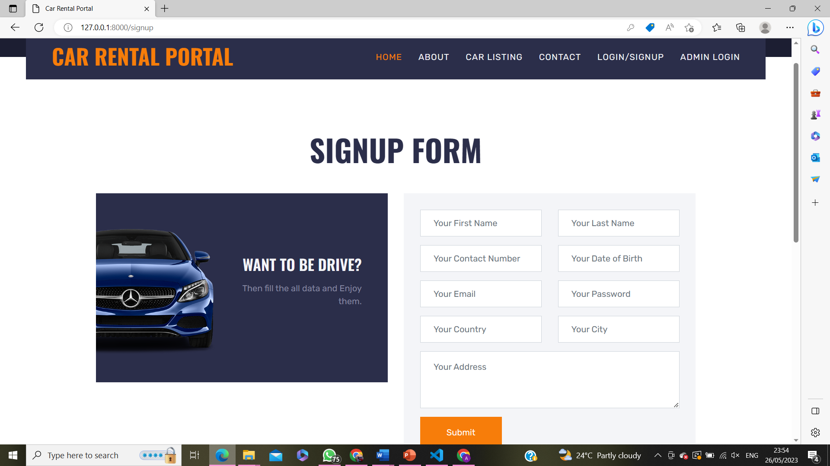
HOME PAGE REGISTRATION

Slide 12
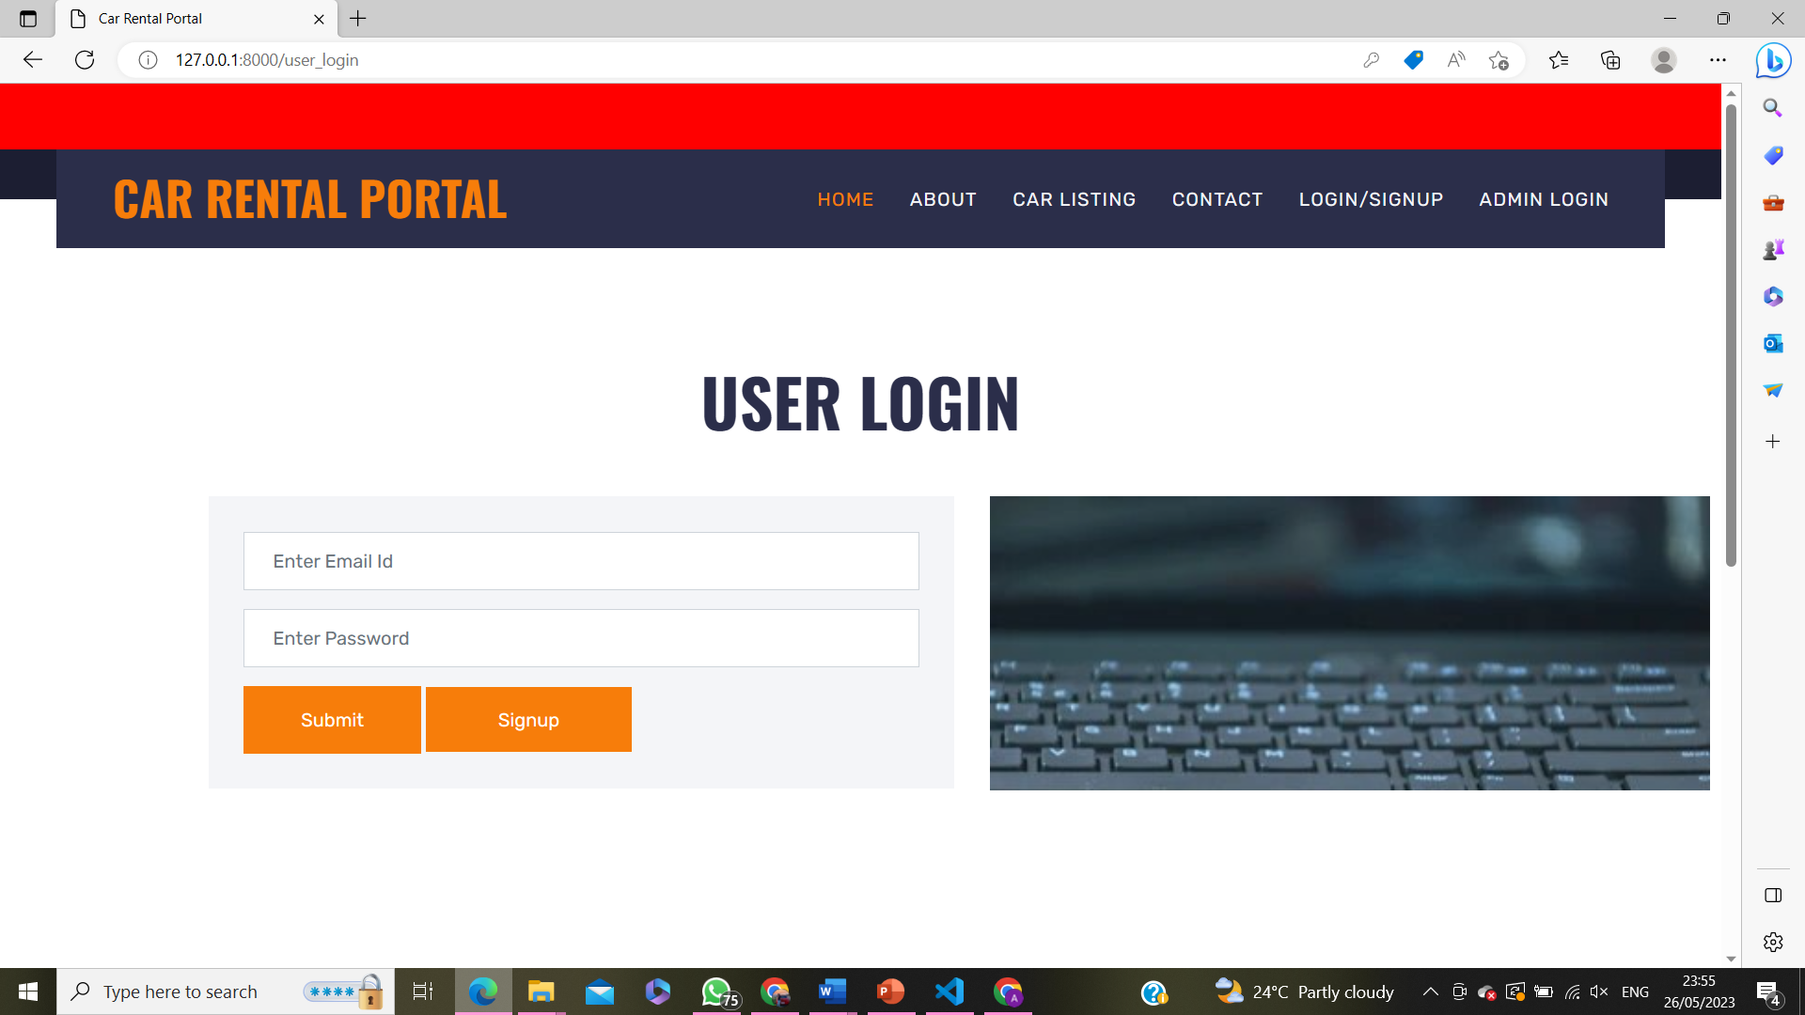
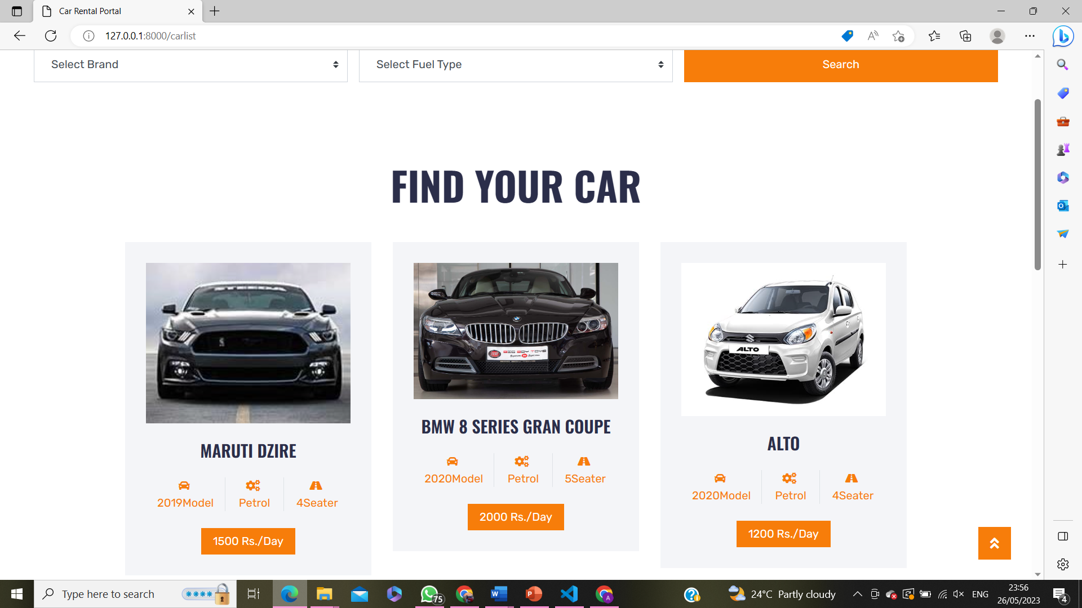
USER LOGIN CARLISTING

Slide 13
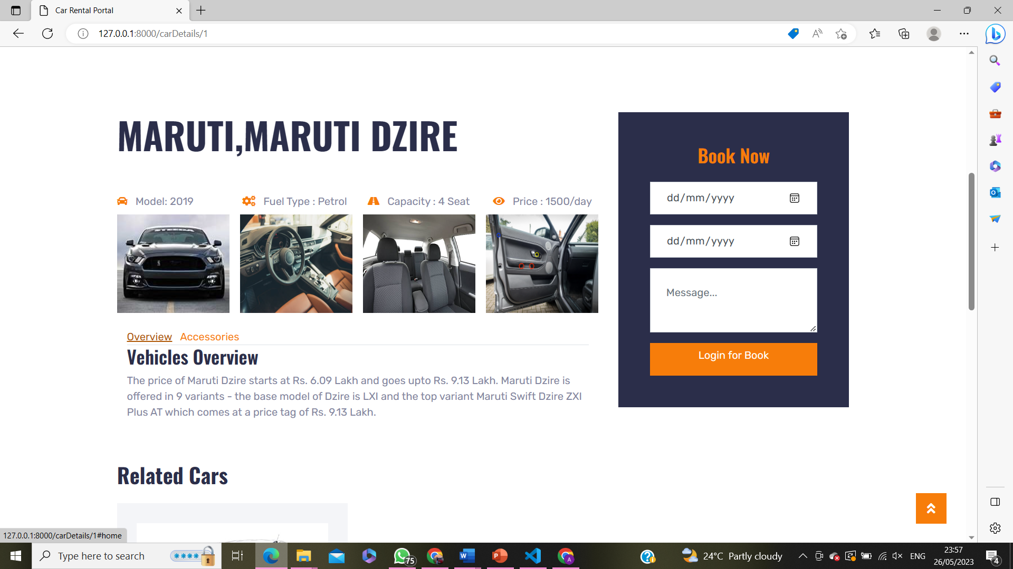
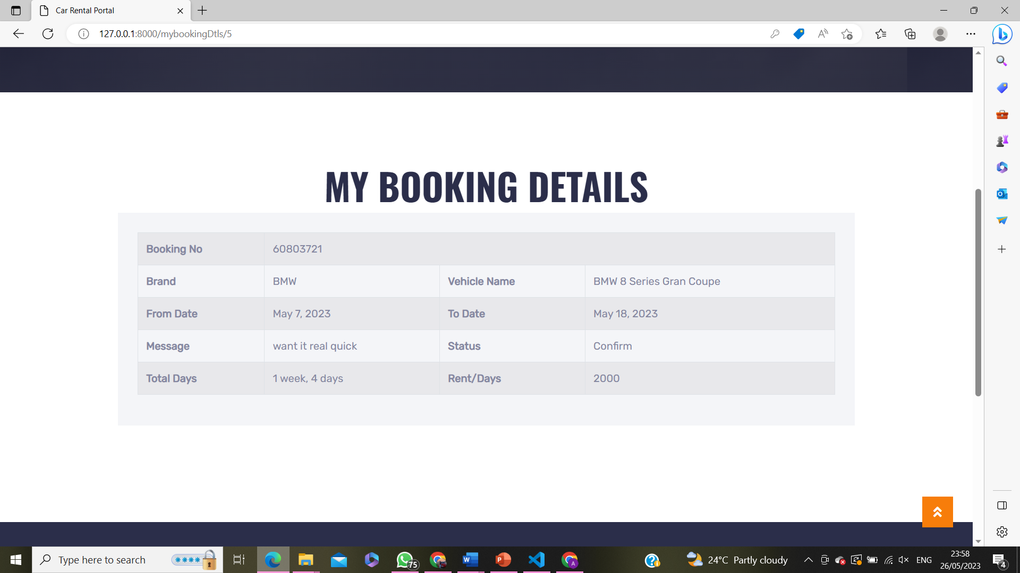
CAR DETAIL BOOKINGS PAGE

Slide 14

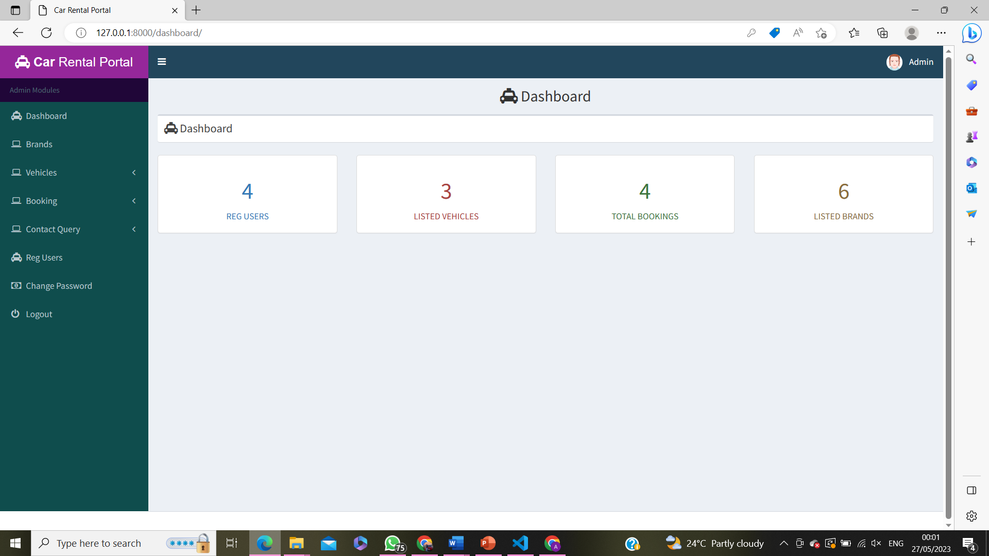
ADMIN LOGIN ADMIN HOMEPAGE

Slide 15
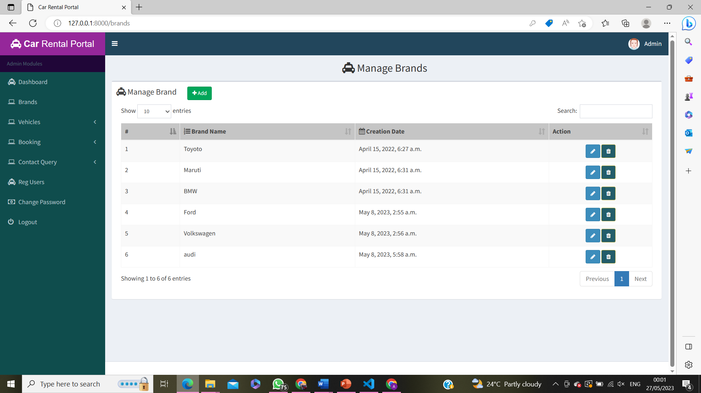
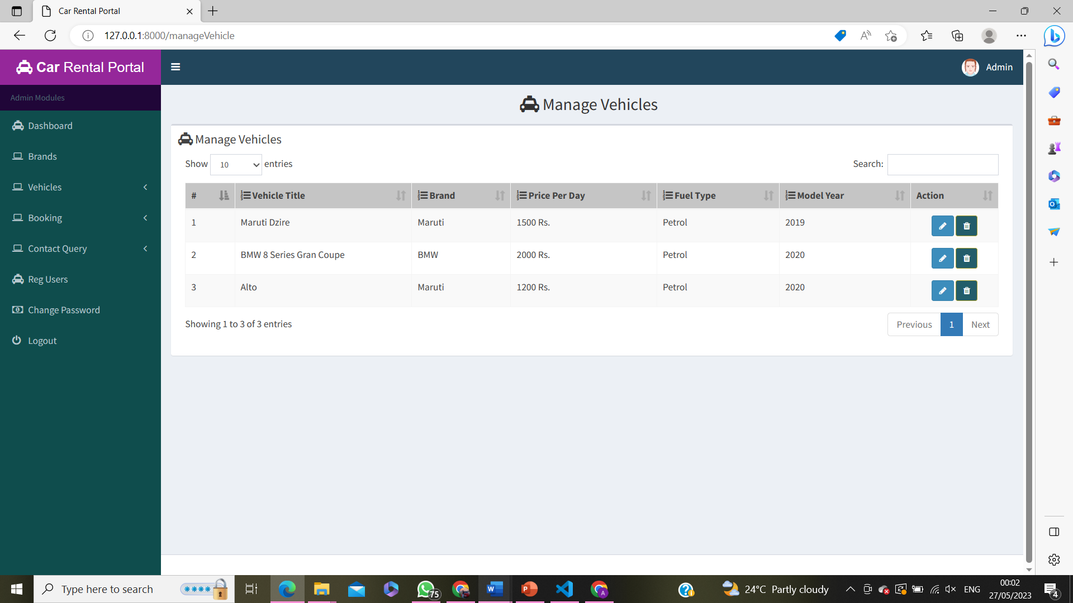
BRANDS VEHICLES

Slide 16
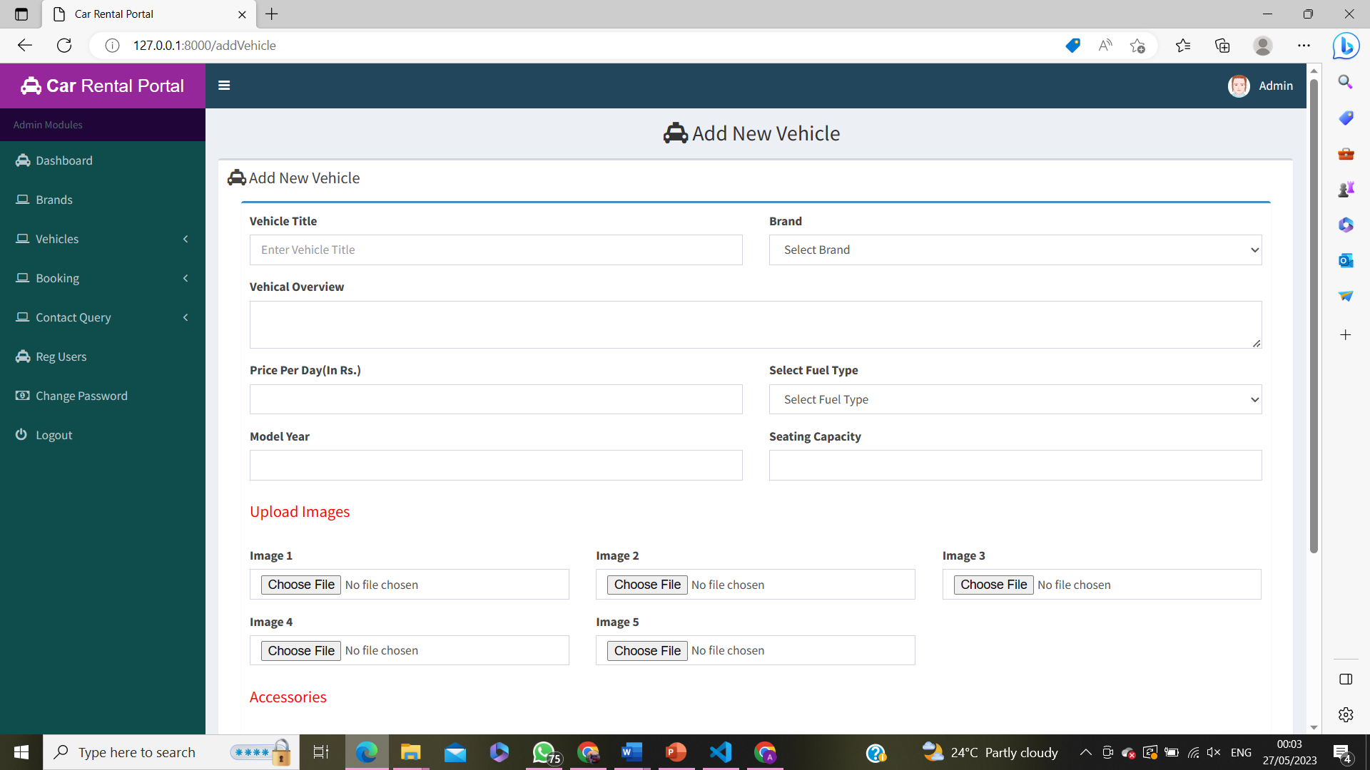
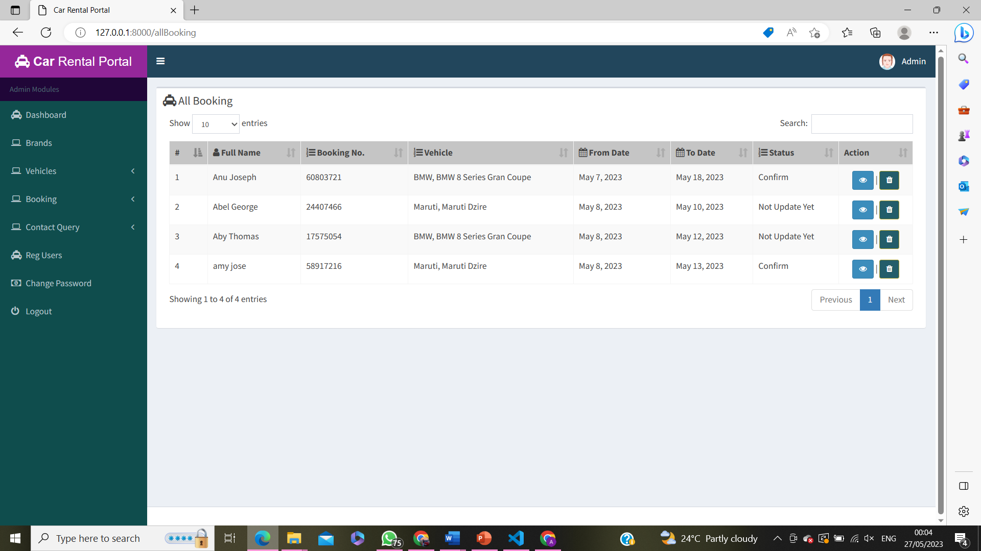
ADD VEHICLE VIEW BOOKING

Slide 17
THANKYOU

